Slide 1
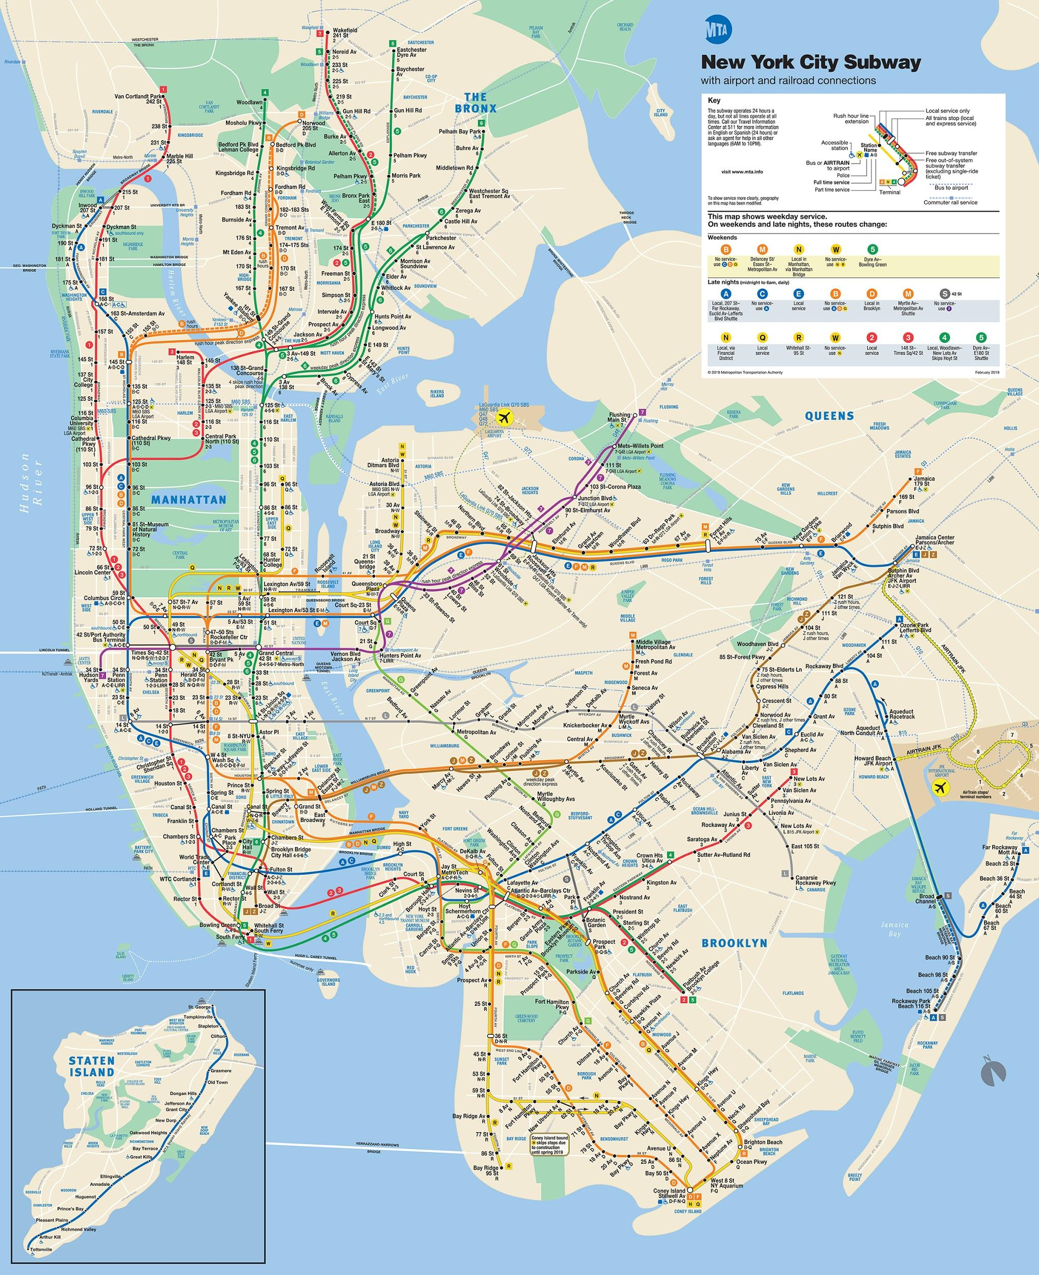
Where did we go on our virtual field trip?
Where is our school?

Slide 2
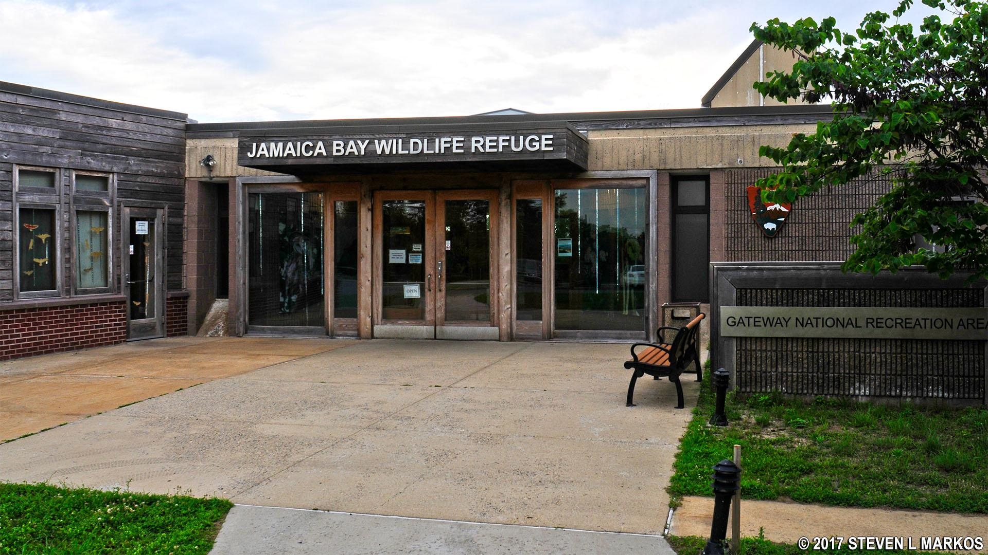
Notes:
The Jamaica Bay Wildlife Refuge is a “refuge” for wildlife.
Have students describe what a refuge is.
You can refer back to the MTA map to show how much habitat is available for wildlife, and how much is available for humans.

Slide 3
Notes:
There are 562 Wildlife Refuges in the United States.
The Jamaica Bay Wildlife Refuge is part of the National Park Service, which means our NATION/COUNTRY protects all of these places from harm. It also means that these places belong to everyone.

Slide 4
Notes:
Who works at a National Park?
Rangers help protect not only the wildlife, but also the history and culture of a place.
QUESTION: Would any of YOU be interested in becoming a ranger?
If so, you could be a ranger...

Slide 5
The Grand Canyon
Notes:
In Arizona at the Grand Canyon.
Or...

Slide 6
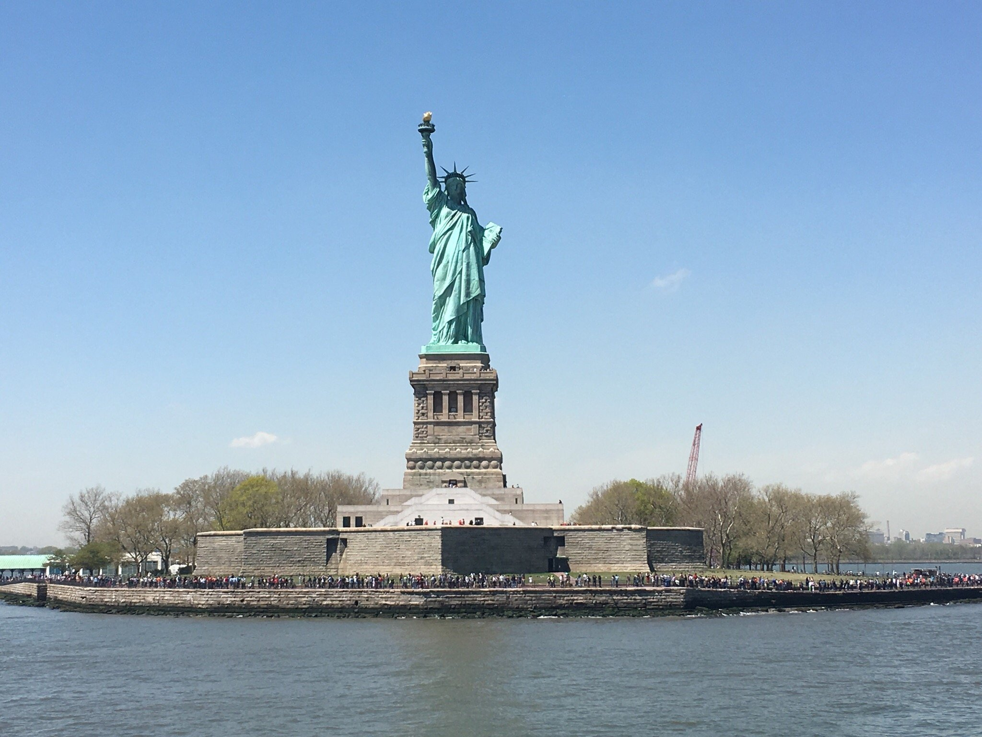
Statue of Liberty
Notes:
You could be a ranger a little closer to home at the Statue of Liberty.

Slide 7
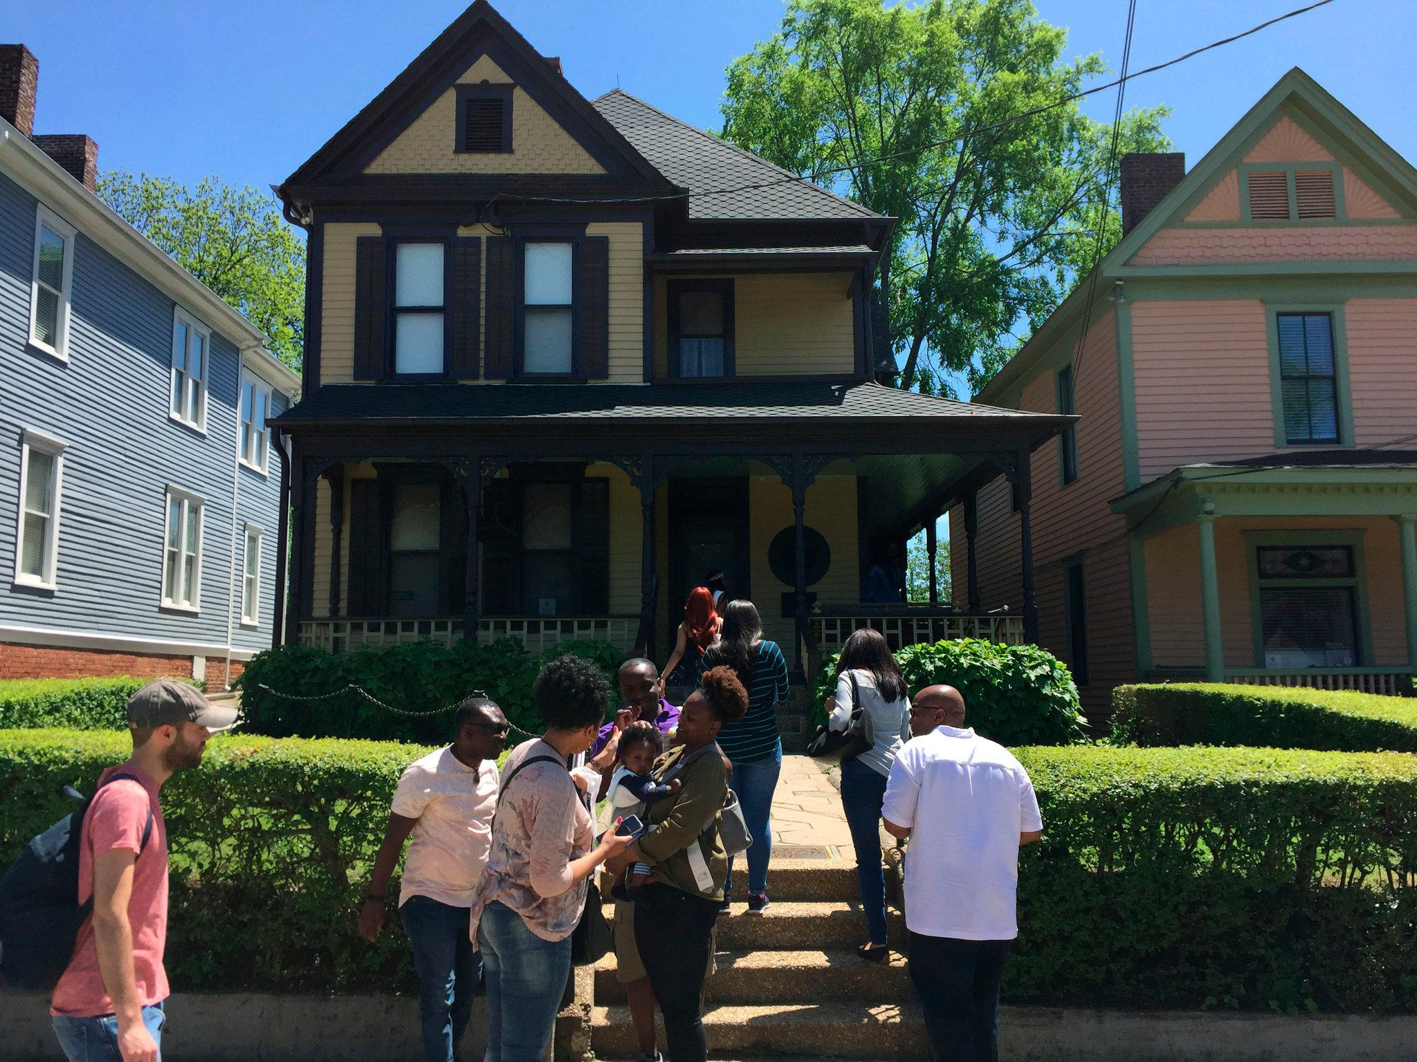
Birth Home of Martin Luther King, Jr.
Notes:
In Florida at Dry Tortugas National Monument.
You can only get here by boat, and it is surrounded by coral reef.
Or...

Slide 8
Notes:
But back to our local National Area, what kinds of habitat are being protected?

Slide 9
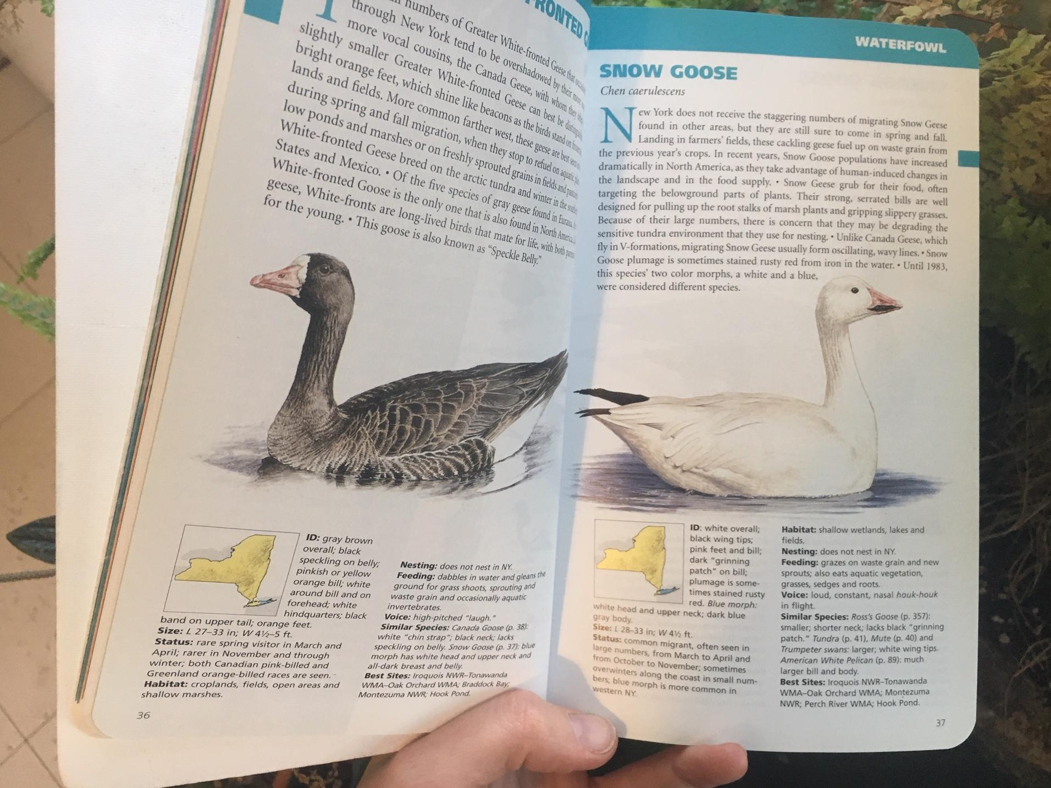
Notes:
A field guide can be used two ways:
-If you see a bird that you don’t know the name of, you can try to find it by the drawings
-Or, if you know the name, you can flip to the back of the book and look up the bird alphabetically, and it will tell you the page

Slide 10
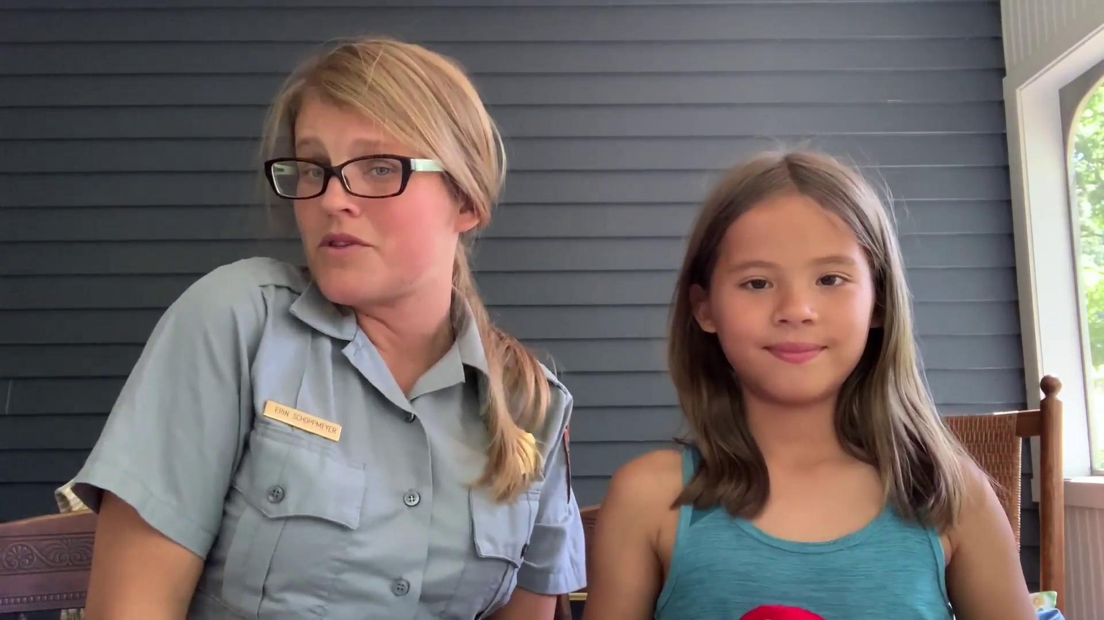
Field Guide Instructional Video

Slide 11
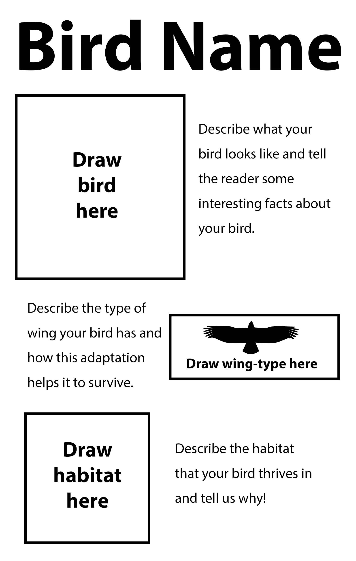
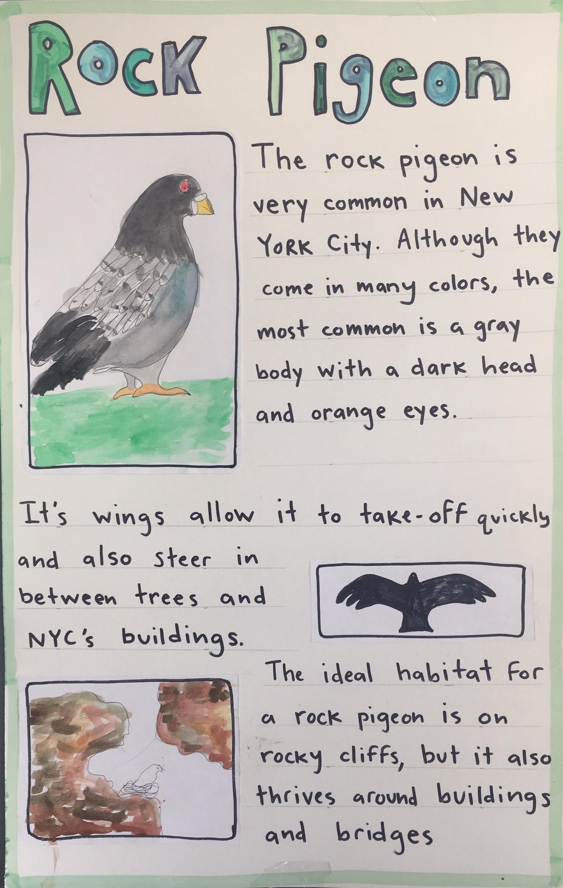
PROJECT STEPS
Choose a bird (it can be your favorite or one you’ve just learned)
Write out the bird’s name BIG AND BOLD
Draw your bird
Draws that bird’s wing-type
Draw the bird’s habitat
Add your descriptions for each drawing
You’ve got yourself a working field guide page!
Notes:
To make our own field guides, we will rely on this format so people can easily find the information they are looking for. Students can use https://www.allaboutbirds.org/news/ to search for their birds and learn this information.

